Slide 1
Title: Hospital Management System
Submitted By:
Name: Muhammad Anas Muhammad Ali
Roll No: 23P-0613 23P-0556

Slide 2
OOP Concepts:
1) Classes & Objects
2)Inheritance
3)Friend Functions
4)Polymorphisim
5)Virtual Functions

Slide 3
Software Modules
Classes:
1) Person
2) Doctor
3) Patient
Structures:
1) Doctor Info
2) Patient Info

Slide 4
Person Class:
Member Functions:
For Achieving Polymorphism we declare all members functions as Pure Virtual Functions.
1) Add Information of New Patient or Doctor
2)Display Information of Specific Doctor or Patient.
3)Details of All Person.
4)Total Count of Doctors and Patients in System.
Additional Member Functions:
Doctor Class:
1) Doctor Salary
Patient Class:
1) Patient Report
2)Generate Bill

Slide 5
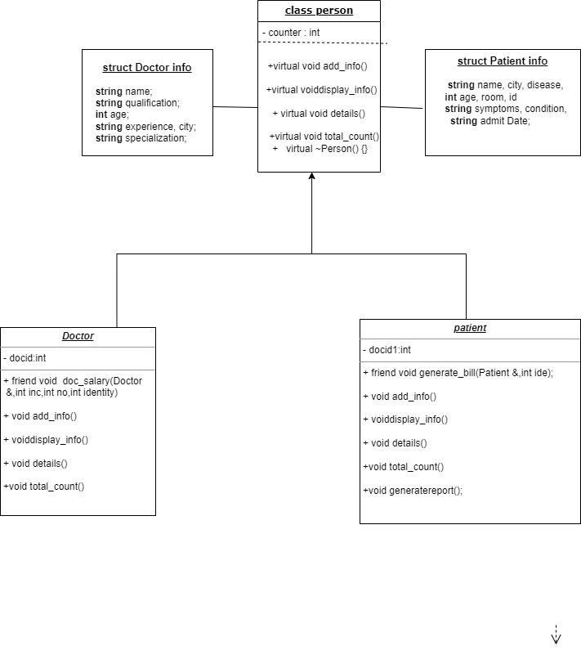
UML Diagram

